Slide 1
Deep History Of the Study of Perception
By: Ahmed Nadeem

Slide 2


Slide 3


Slide 4
Warning
- Background Color indicates progression through time
- black = past
- shades of blue = recent history
- white = now
BCE and Middle ages
Recent History
Present Day

Slide 5
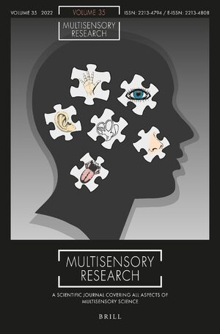
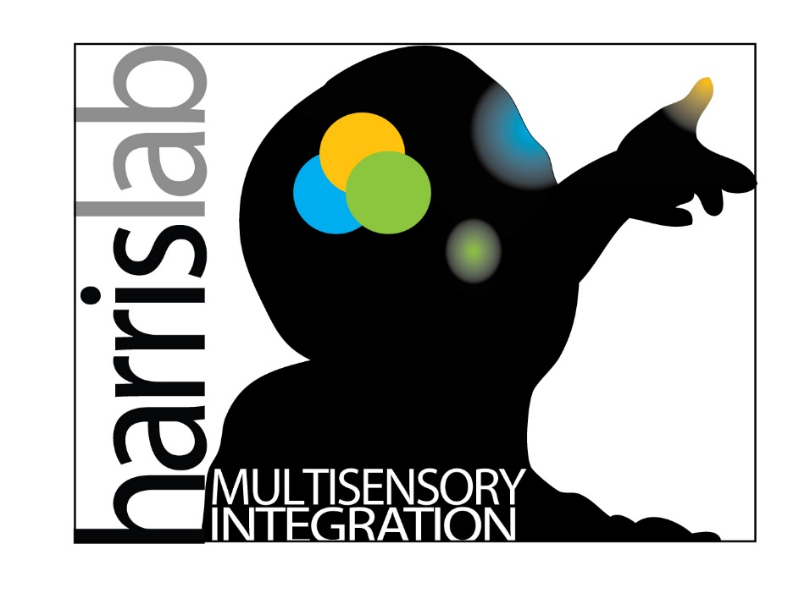
Content / Biological Topic
Before we begin
Notes:
Give a run down of who you are and what you do
I study haptic sense perception
This means I study a lot of, how do people understand and process what they see. Is what they see real/or is there a bias or misleading aspect in how human beings, how the homo sapien species perceives the world.
I mainly work on haptics which means touch, I like to focus around the hands but I plan to study haptic perception across the body and perhaps around the lower appendages (maybe).
The purpose of this work, for those who are curious is to develop better VR and AR experiences and make these systems for the future more refined and better suited for human use and exploration.
Or if not applicable there, then we can at least develop treatments and more advanced methodologies in diagnosing diseases or better assessments of human ability for various hand based experinces. Like, how well can your doctor place a robot arm at a specific point, to consider

Slide 6
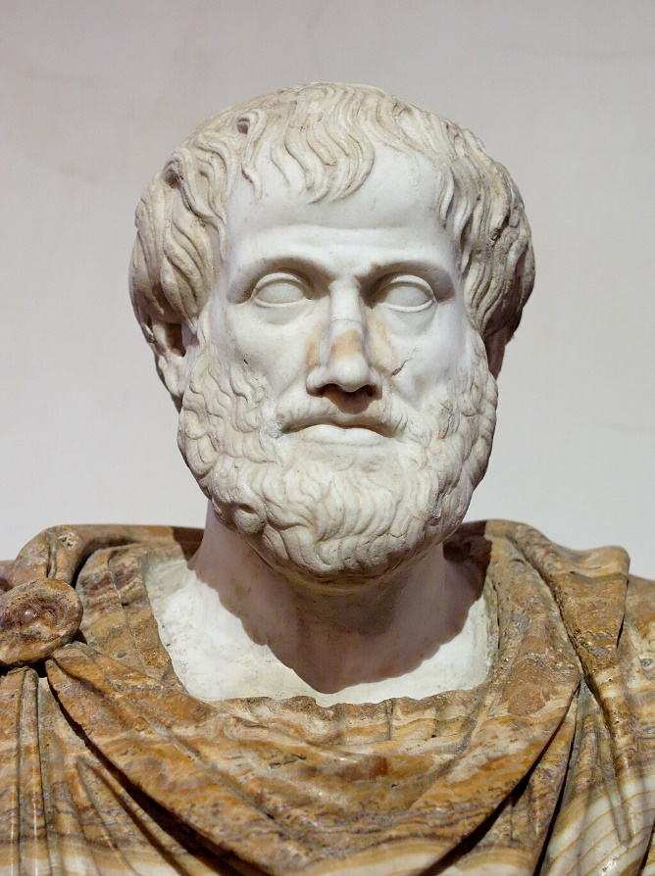
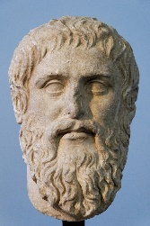
Ancient Philosophers - Sense
Intellect and perception?
Empiricism
Perception?
Senses?
Plato
Theory of forms
Knowledge?
Aristotle
Notes:
- go over and study these ideas
Theory of forms (we cant see real reality)
Empiricism -> sensory knowledge is what we have to study reality
-- plato was basically like, wahat is senses, what is perception, what does it mean to have knowledge of the world.

Slide 7
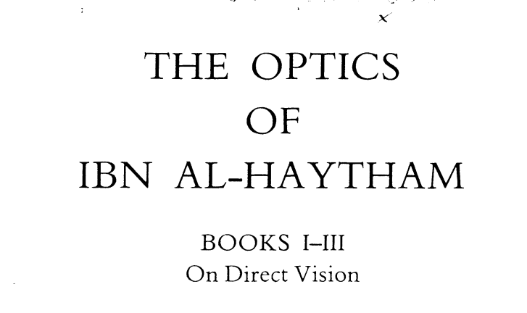

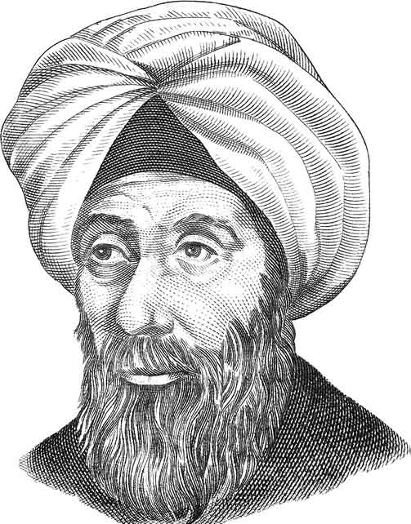
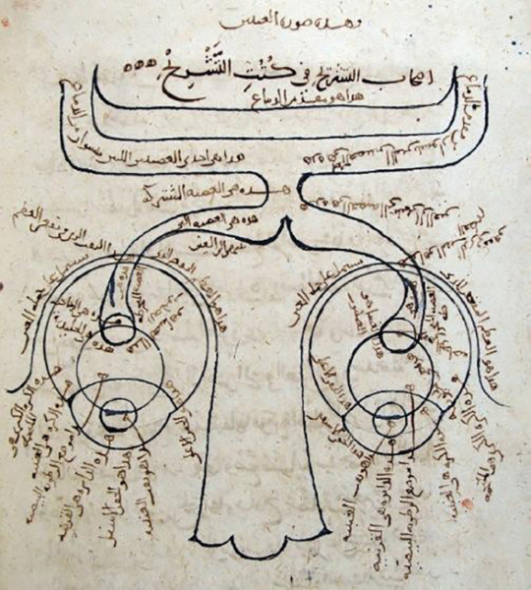
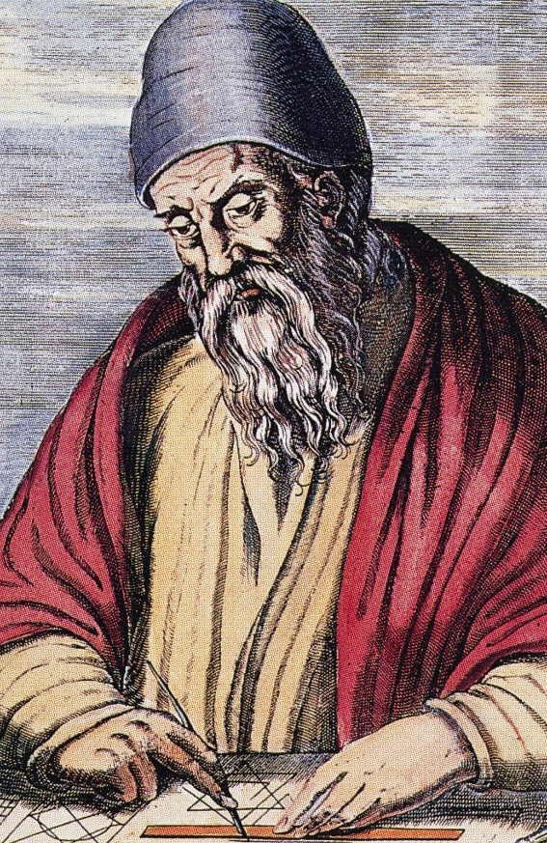
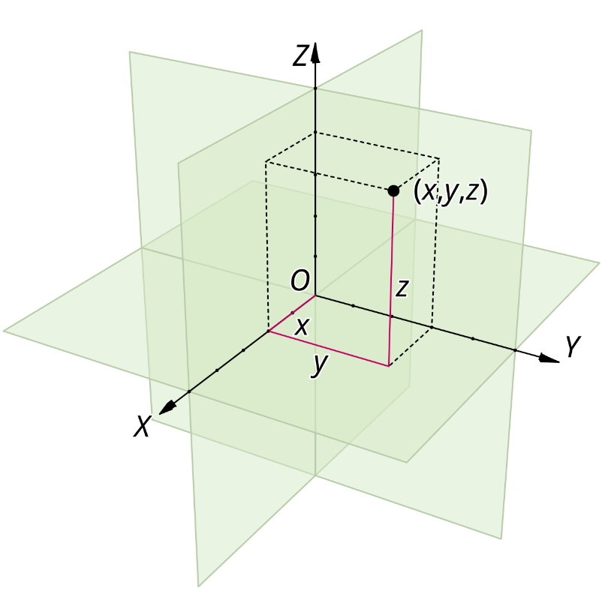
Ancient Philosophers PT.2
Euclid
Ibn Al-Haytham
Notes:
Next we have Euclid, and im only covering really important people and ideas, or people who will be reference a lot later on,
Eculid is the most amazing vcuz he defineid and made the concept of euclidan space real, and something that we can discuss and work around / with
Ibn al-haytham, he came almost 1000 years later but was the first studier of optics, geometrically and also of human vision and biology, showing here the optic chasm

Slide 8

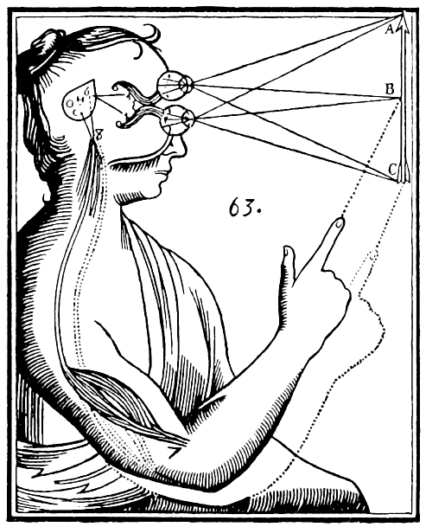
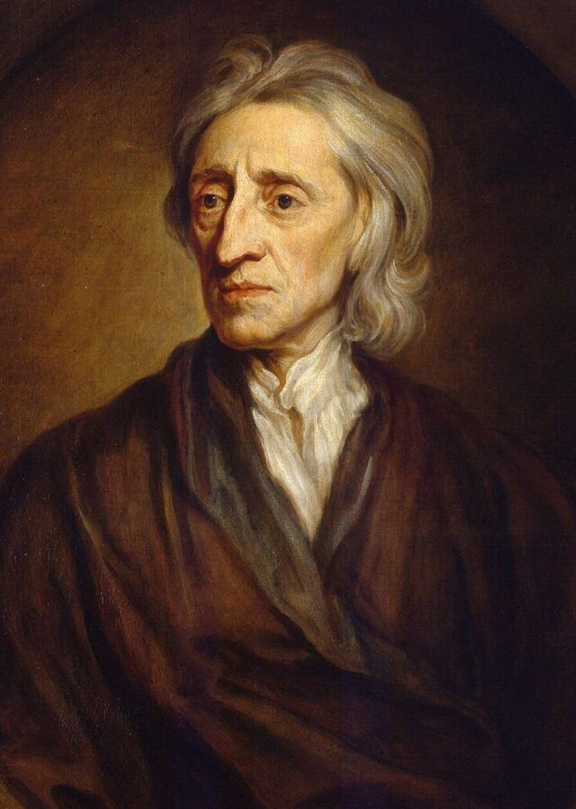
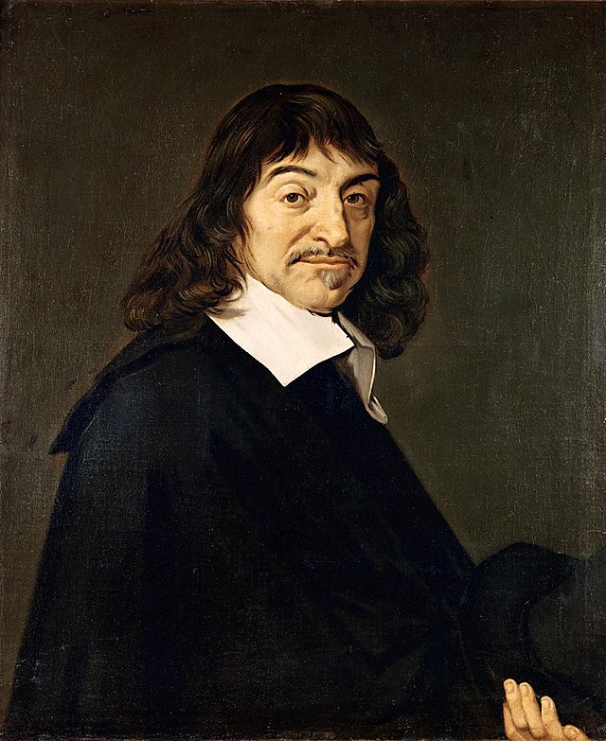
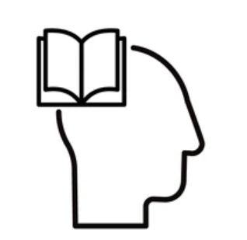
Pre Scientific revolution – 1800
Empiricism
Start of the
Scientific method

Slide 9
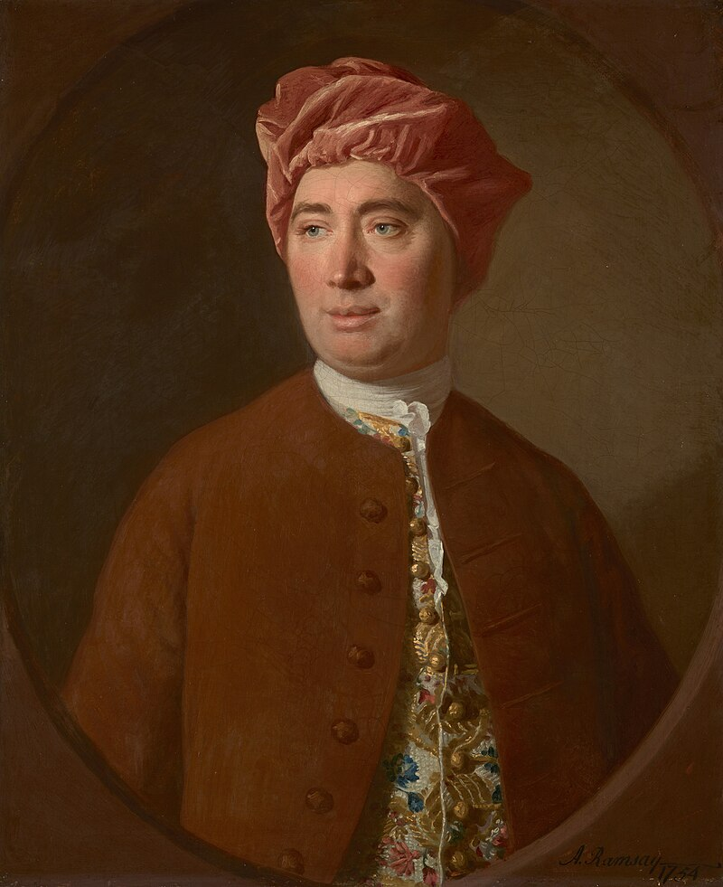
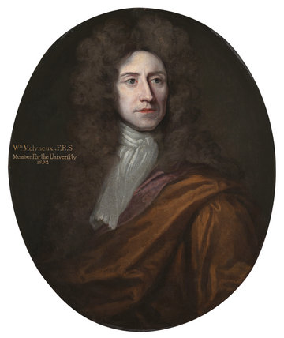
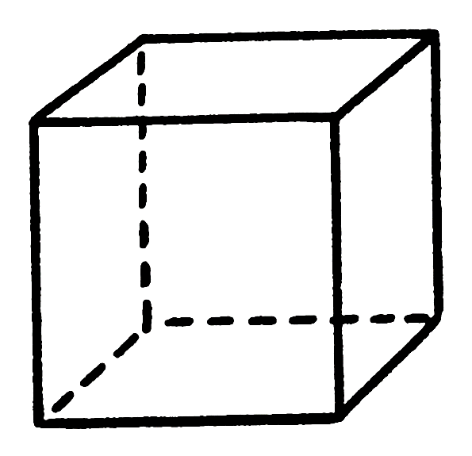
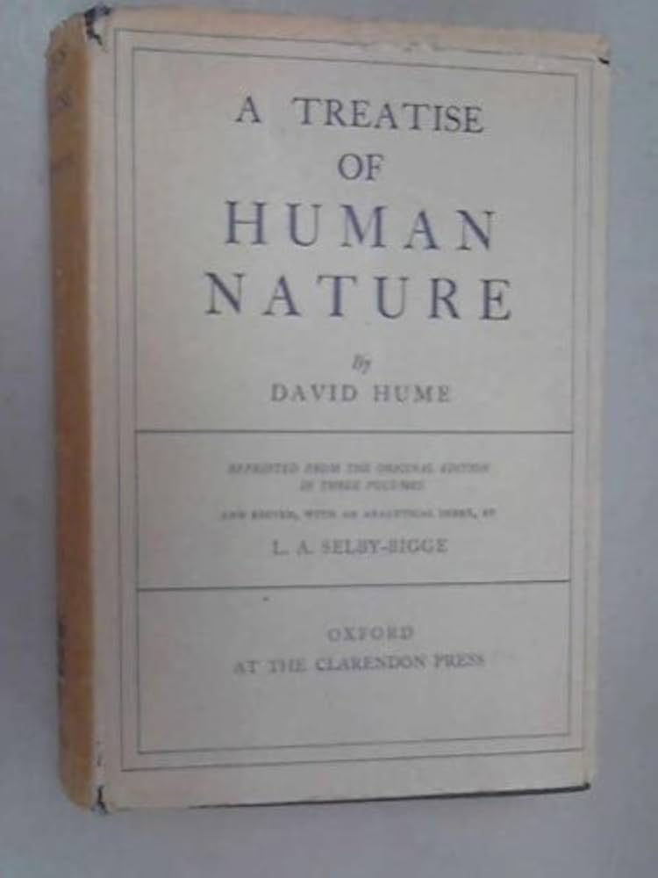
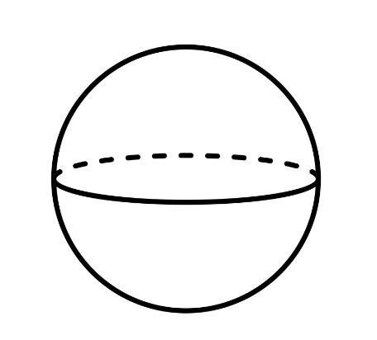
Pre Scientific revolution – 1800

Slide 10
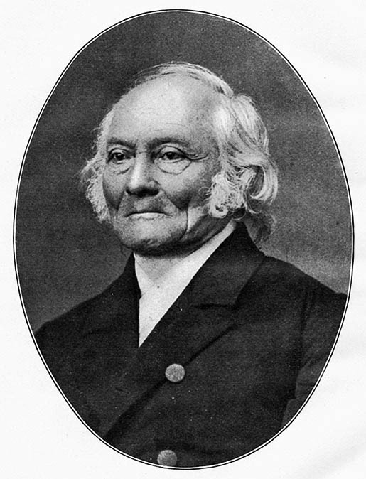
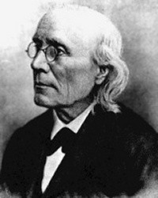
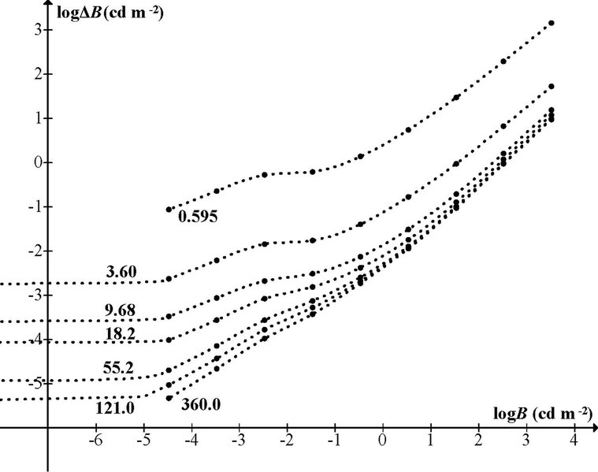
Pre Scientific revolution – 1800

Slide 11
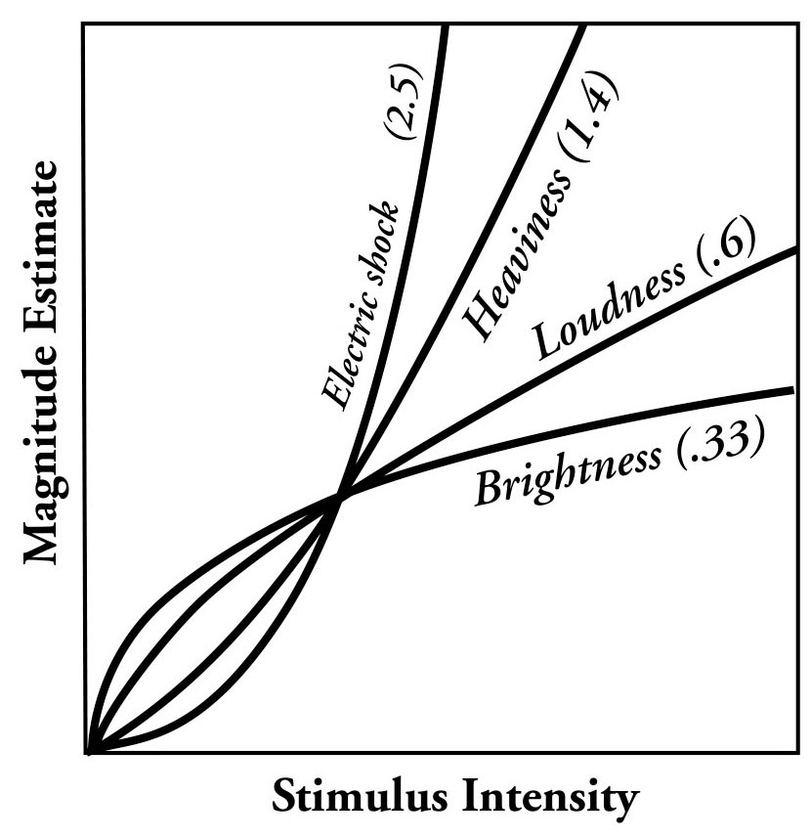
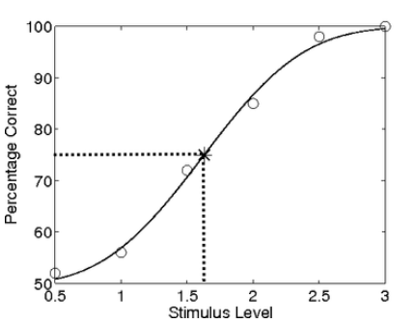
Pre Scientific revolution – 1800

Slide 12
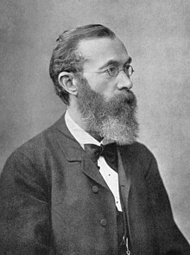
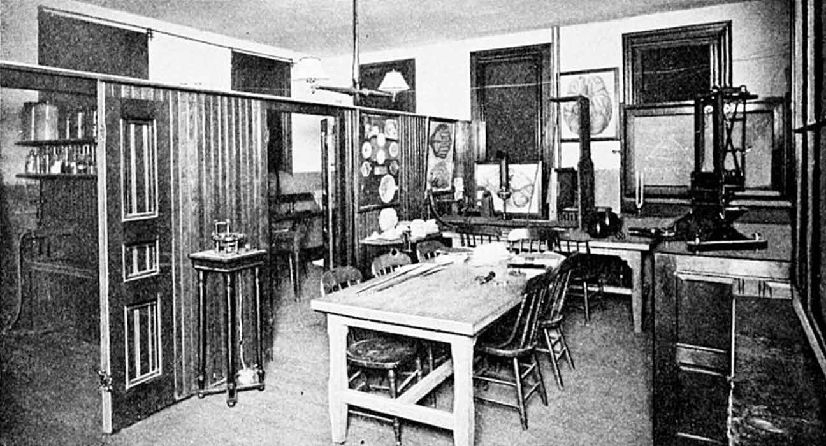
1800s onwards

Slide 13
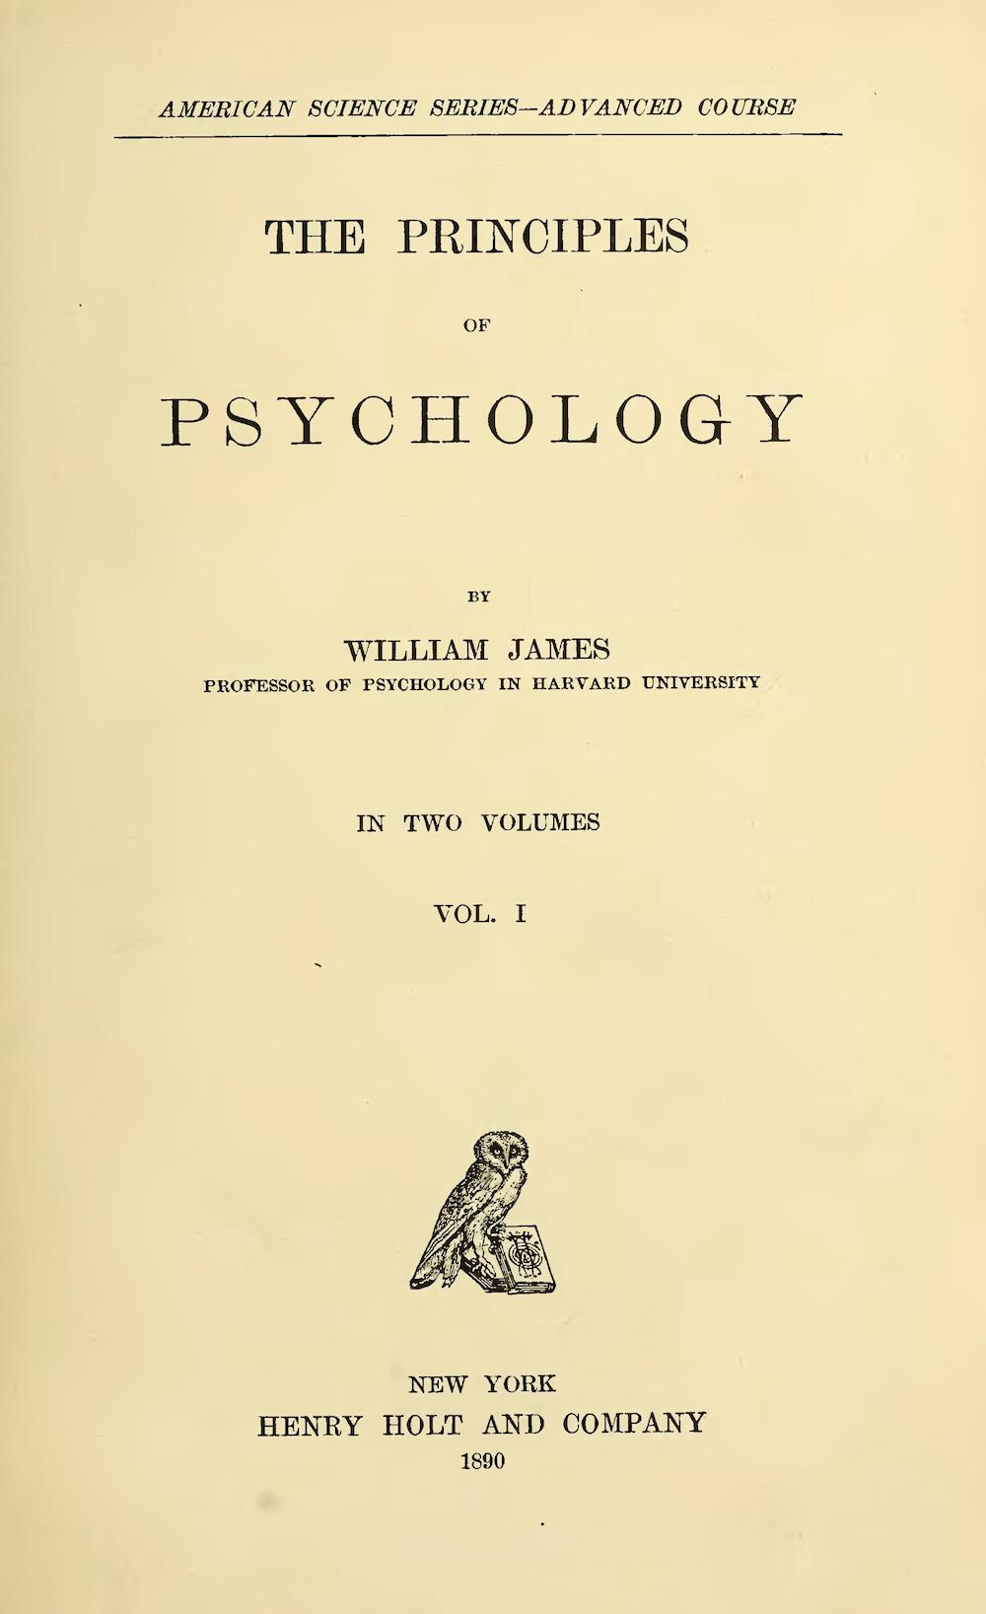
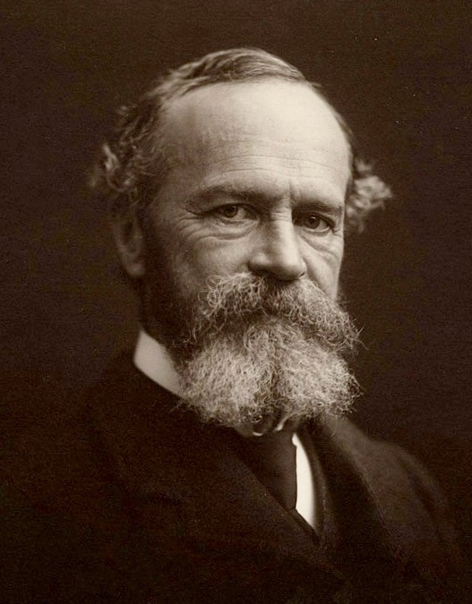
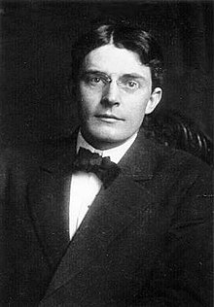
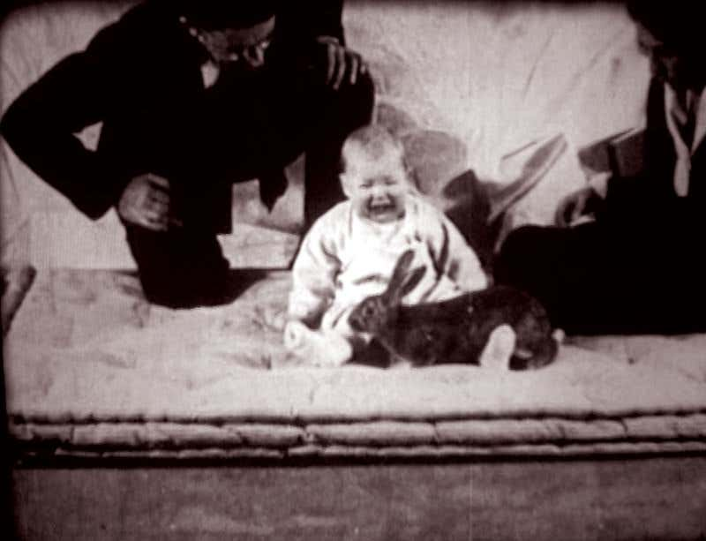
1800s onwards

Slide 14
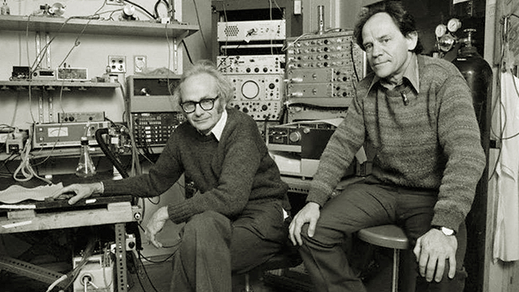
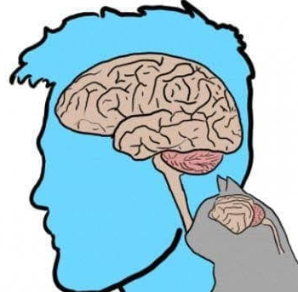
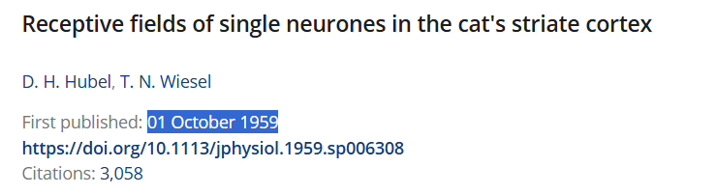
1900s-1950s onwards
Behaviorism/Psychology
Philosophy/Math
Physiology?
Notes:
- The older guyt, david hubel, acc made the tungsten electonde

Slide 15
1900s-1950s onwards
Behaviorism/Psychology
Philosophy/Math
Physiology?

Slide 16
1950s-1999
Behaviorism / Psychology
Biology
Philosophy / Math
Computers
Physiology?

Slide 17
1950s-1999
- Gibson - ecological optics
Daivid marr – computatiooal neuroscience and vision
Melyvn goodale -> visual strea hpyothsisis
Ian P howard
Susan Lederman (born 1944) and Roberta Klatzky (born 1947): Their collaborative work on haptic perception and object recognition has been prominent since the 1980s and continues to influence the field.

Slide 18
2000s-Present
- ml kappers
- harris

